Slide 1

Cereal analysis

Slide 2

TEAM MEMBERS
Praneeth
Sidhik
Teja Srinivasu
Srujan
Ram Vardhan

Slide 3
TABLE OF CONTENTS
PROBLEM STATEMENT
OBJECTIVES OF RESEARCH
DATA SET
DESCRIPTION
DESCRIBE
CORRELATION
COVARIENCE
DATA VISUALISATION
DATA MODELLING
MULTIPLE LINEAR REGRESSION
OLS MODEL
TRAINING AND TESTING
ACCURACY
OUTLIERS
CONCLUSION

Slide 4
PROBLEM STATEMENT
Usually a customer expects to consume dietary cereals with high proteins, fiber and low sugars, fats. Predicting a brand with high dietary cereals became a big issue.
Hence we came up with supervised machine learning where we can predict the brand ratings using Multiple linear regression.

Slide 5
OBJECTIVES OF RESEARCH :
The project objective is to find the high dietary food that is predicted on the basis of rating of the food. The research should achieve the best food with high diet analytics.
The food is rated accordingly to get dietary benefits . Rating is given high for the food with high protein , fibre , vitamins and Rating is given low for the food with low fats , sugars , etc
The main objectives of the project are :
To find Which quantities are showing more impact on the rating of food
To show the food which is impacting less on the rating of food
Measure the inputs and outputs
Collect the data set
Find how the quantity is impacting rating
Use different ML algorithms to predict which food has high dietary benefits

Slide 6
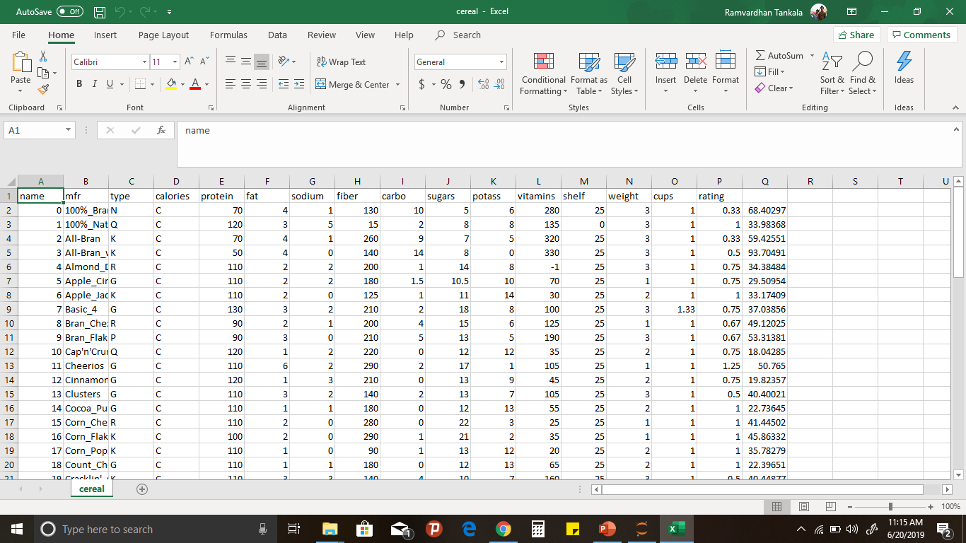
DATA SET

Slide 7
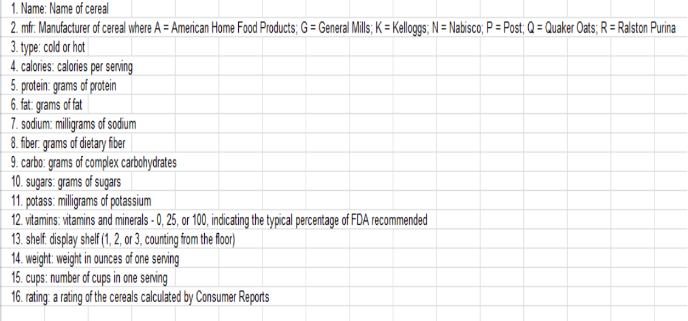
DESCRIPTION
OBSERVATIONS=77
VARIABLES=16

Slide 8
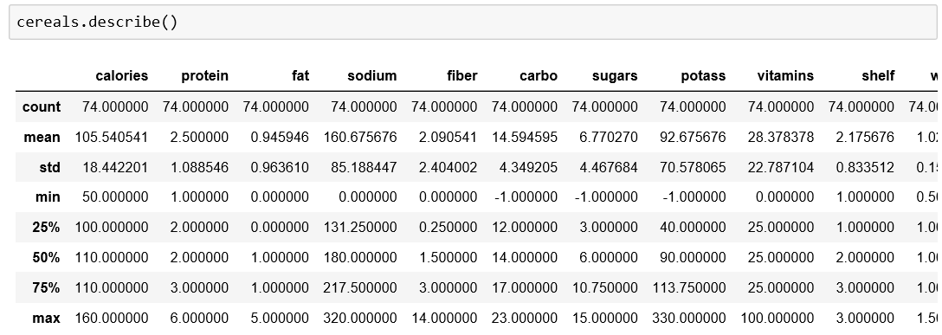
DESCRIBE

Slide 9
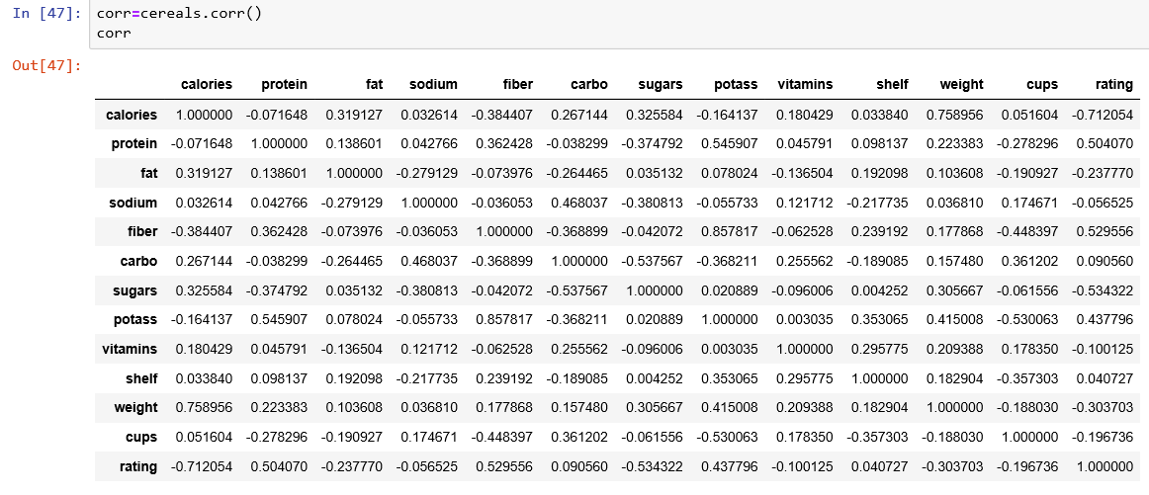
CORRELATION
Correlation is a statistical measure that indicates the extent to which two or more variables fluctuate together. A positive correlation indicates the extent to which those variables increase or decrease in parallel; a negative correlation indicates the extent to which one variable increases as the other decreases.

Slide 10
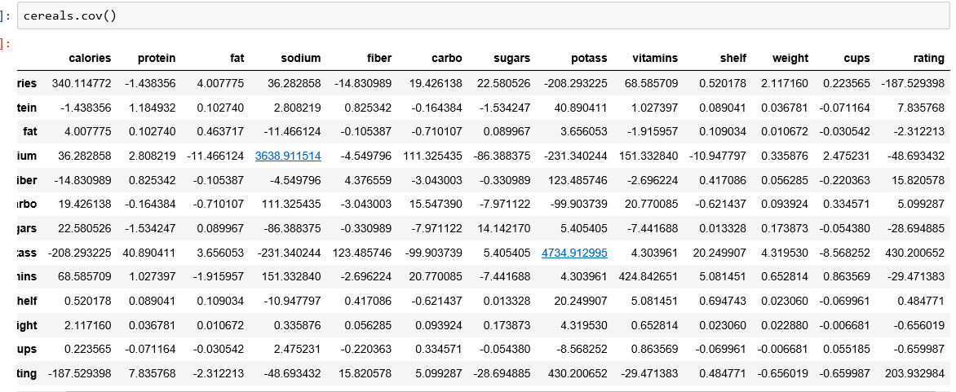
COVARIENCE
Covariance is the measure of relationship among different variables.

Slide 11
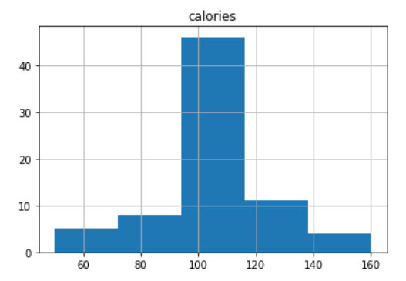
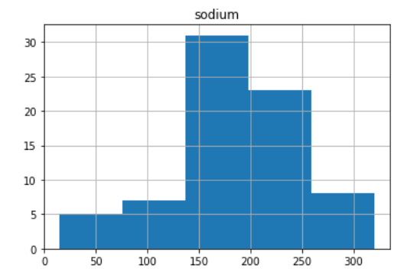
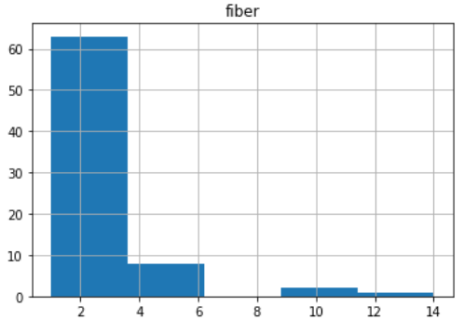
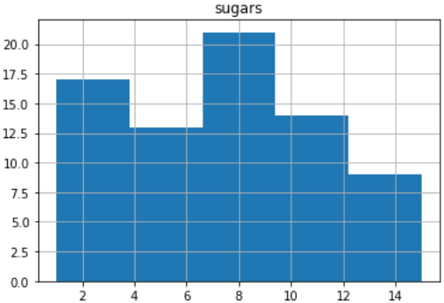
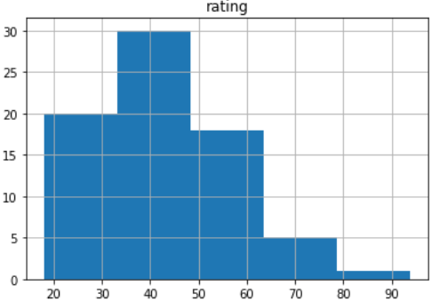
DATA VISUALISATION

Slide 12
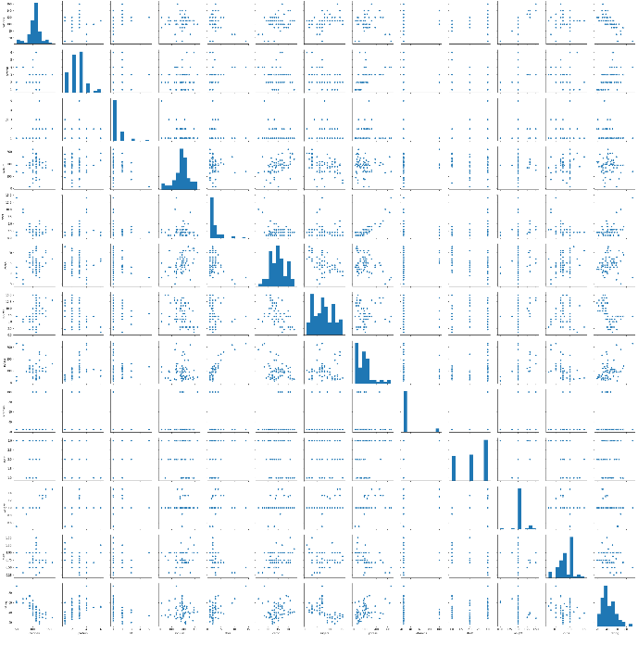
SEA BORN

Slide 13
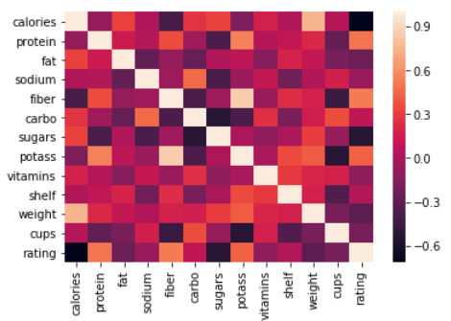
HEAT MAP

Slide 14
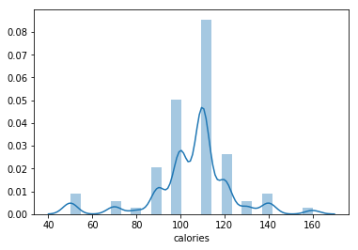
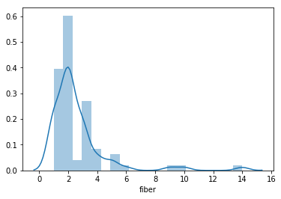
DISTPLOT

Slide 15
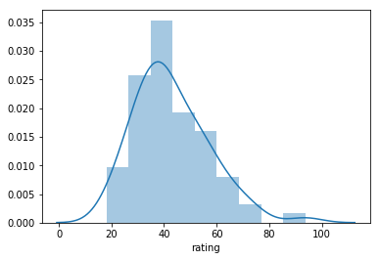
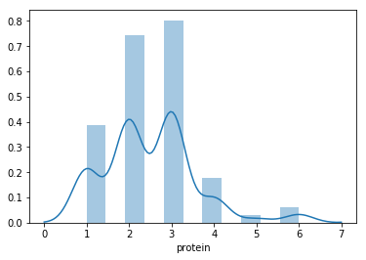

Slide 16
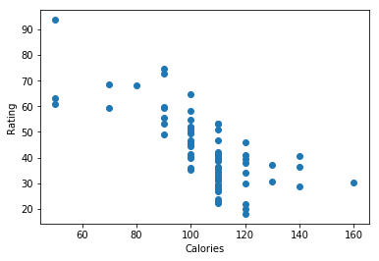
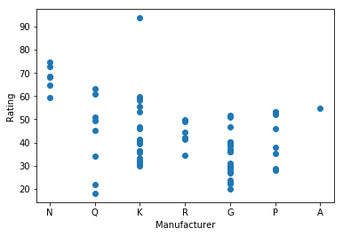
SCATTER PLOTS

Slide 17
Data Modelling :
In this project Multiple Linear Regression is used.Given Data set consists of different items.We take multiple inputs for the prediction of output.In given data , 6 quantities are taken as inputs for the prediction of output.The inputs taken are
Calories
Protein
fat
carbo
Fiber
sugars
From these inputs given ,Rating can be predicted. We use matplot and boxplot functions to plot different graphs and maps to determine the dependency of each quantity with the prediction.

Slide 18
MULTIPLE LINEAR REGRESSION
In the given data the target values are continuous so, we need to use Regression.
Basically, we can’t predict the rating of a brand only with one predictor.
Hence, we need to take multiple predictors to predict the target.
So, here we used MULTIPLE LINEAR REGRESSION by taking 6 predictors and 1 target.
PREDICTORS: Calories, Proteins, Fat, Fiber, Sugars, Carbo.
TARGET: Rating.

Slide 19
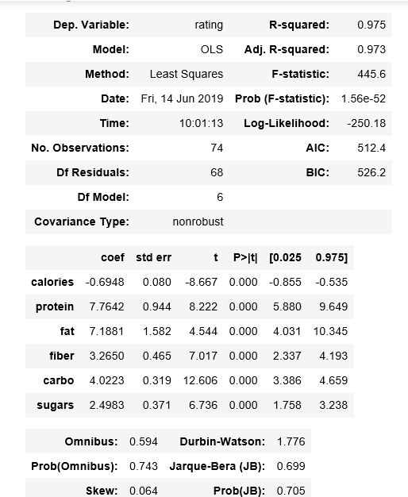
OLS Model

Slide 20
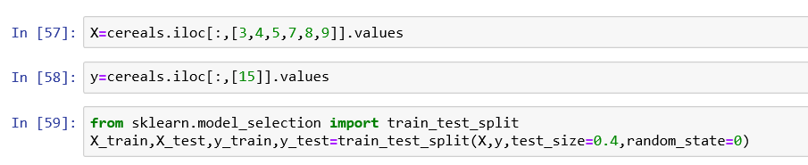
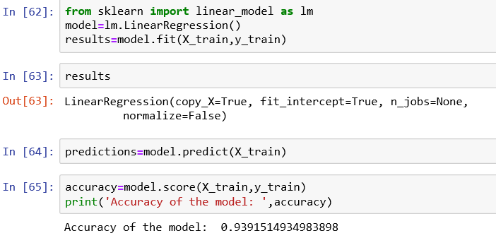
Training and Testing
Here, the test size is 40% and train size is 60%

Slide 21
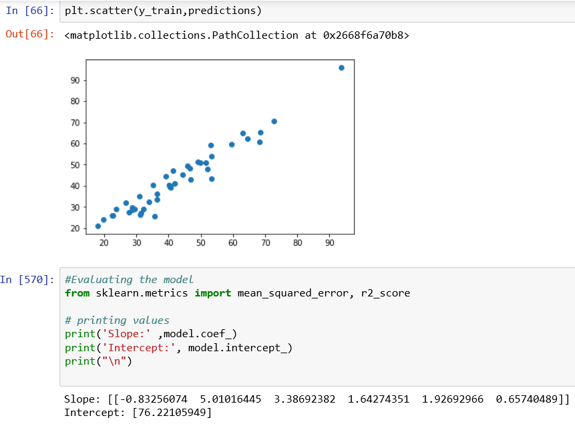

Slide 22
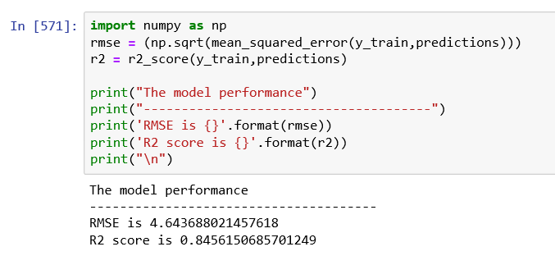
RMSE AND R-SQUARED VALUES

Slide 23
Comparison of Ratings
Cereal Brands | Highest rating(93.704) (all_bran_with_extra_fiber) | Lowest rating(18.042) (Cap’n’Crunch)
Calories | 50 | 120
Proteins | 4 | 1
Fat | 1 | 2
Fiber | 14 | 2
Sugars | 7 | 12
Carbo | 8 | 12

Slide 24


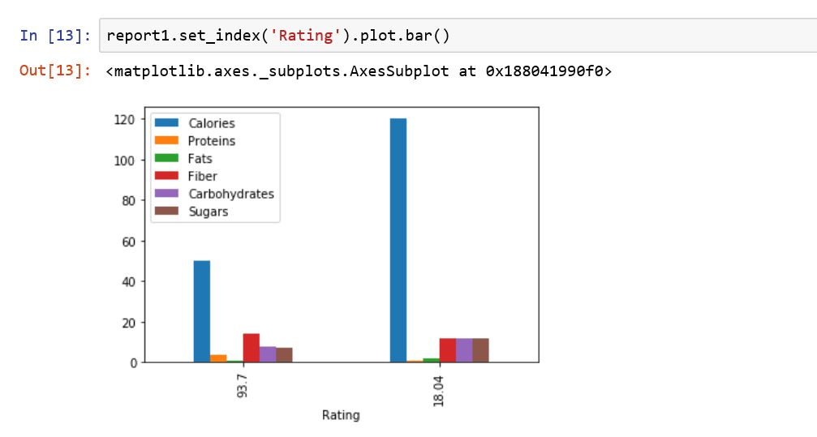




Slide 25
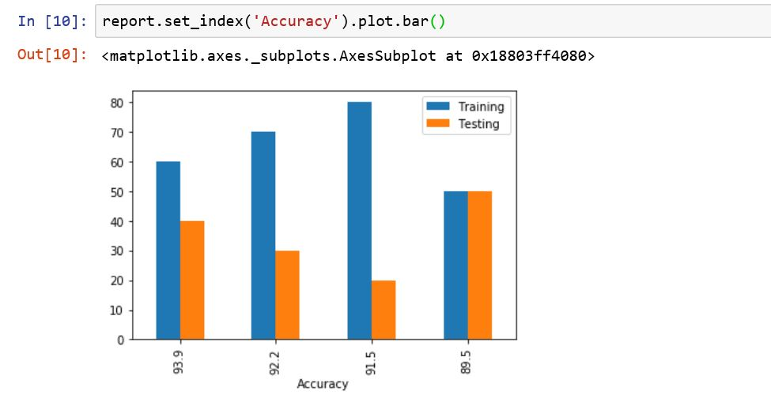
TRAINING | TESTING | ACCURACY
60% | 40% | 93.9%
70% | 30% | 92.2%
80% | 20% | 91.5%
50% | 50% | 89.5%

Slide 26
CONCLUSION
So, here we conclude that 40% testing and 60% training is the best model, as it has 93.9 accuracy.

Slide 27
THANK YOU

